Slide 1




Cyber Readiness Program
Protecting Our Business with the
Cyber risk is on the rise, especially
with the increase in remote work.
The Cyber Readiness Program helps small businesses better
protect their reputation, data, employees, vendors, and customers
– with just a few hours of company time and at no cost.

Slide 2

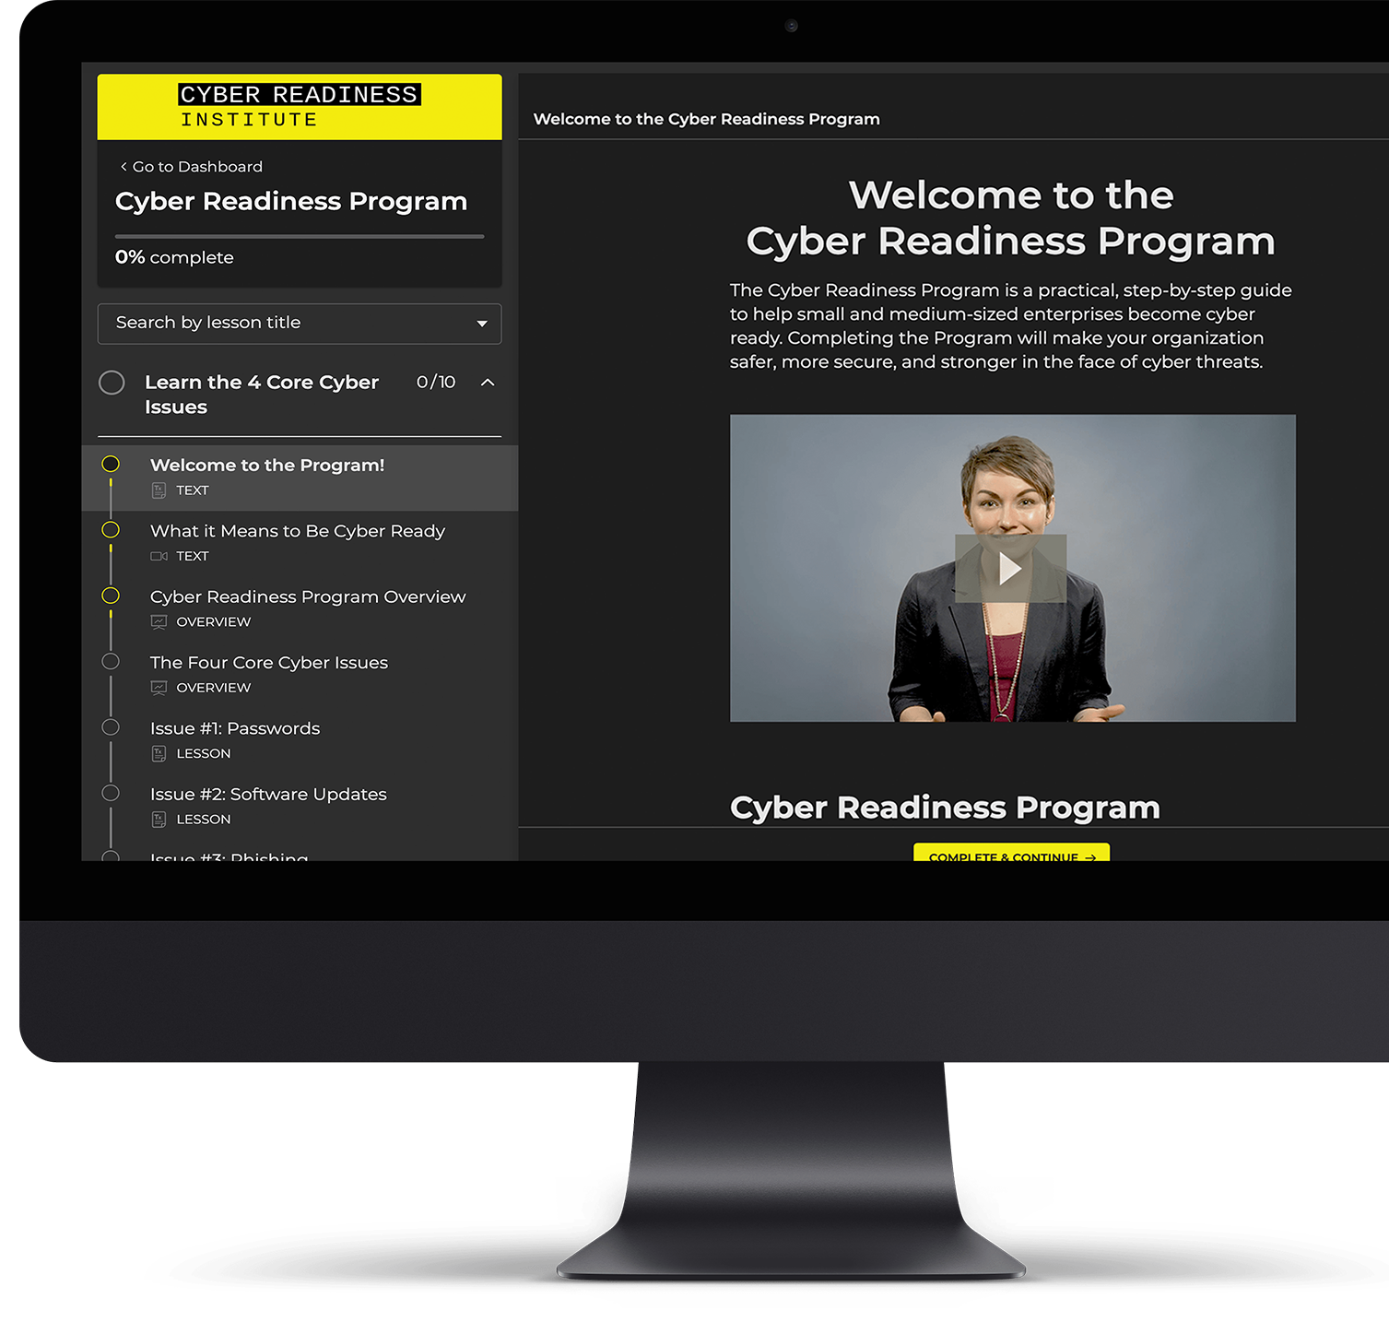

About the Program
The Cyber Readiness Program is a free online program that helps small to medium-sized enterprises reduce cyber risk for through security management training and workforce security awareness training.
Founded by cybersecurity experts from

Slide 3
Is Security Awareness Training
Needed for Small Business?
67%
$4M
53%
of small to mid-sized businesses fail to survive a cyber breach.
average cost of
a data breach.
suffered a security breach
caused by a 3rd party.

Slide 4
Why does Security Awareness Training Work?
Hackers exploit common habits and predictable behaviors to get past the most advanced security technologies.
Human behavior is the foundation of cybersecurity, especially for small and medium-sized companies.
When employees know what to do and understand how to engage with technology, businesses are much less likely to fall victim to these attacks.

Slide 5
Practical Security Awareness Training
Specifically designed for how we work.
Cyber Readiness Program
for Small Business
Easy-to-use cyber security program that works for any type of business
Reduces risk with security awareness training
Simple structure that improves security for any team/role
Helps assess and track security resilience
Minimal time to complete
No technical knowledge required to use
No security or technology costs to implement
Online-based for remote, contract
and onsite workers
77%
of participants reported
that the Program had a high
impact on their organization

Slide 6


“
While we have great external IT management, we were missing strong internal policies and training for our workforce. The Cyber Readiness Program has helped us put policies in place and given us the tools to effectively roll them out and provide ongoing training.
Highly recommend this Program to small businesses who don’t have a dedicated IT team. A lay person can take on this Program, even if IT isn’t their expertise. It is so important to have this internal process, even if your business has external IT management.
”
– HR Manager, Wyoming Roofing
(<100-employee business)

Slide 7

Program Steps to Cyber Readiness
Select a Cyber Leader
for your Business
to take the brief, online security management training program and facilitate the training for our employees
Download the Cyber Readiness Playbook
and Employee Training Toolkit, which are ready-to-use templates that provide simple, clear directives on handling core cyber issues and can be customized in minutes
Receive a Cyber
Readiness Certificate
and ‘Cyber Ready’ badge that can be used on our company website, marketing materials and social profiles to share this commitment to our corporate network

Slide 8
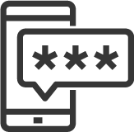



What’s Covered in the Program
Cyber Readiness Program Addresses the 4 Core Cyber Issues
Strong Passwords
Weak or stolen passwords cause 2 out of 3 breaches. Learn how to easily make and manage hard-to-crack passwords for every account in your business.
Phishing
Hard to spot phishing messages can result in an employee accidentally compromising security. Learn the red flags and train employees to avoid opening corrupted files or responding to criminals with sensitive information.
Software Updates
Most attacks exploit known software vulnerabilities that have already been fixed. Learn how to automate software updates system-wide and teach employees to install updates promptly.
USBs
Removable media like USBs can be an easy way
for hackers to get in. Learn how to safely store
and share files without this risk and how to use removable media when necessary.

Slide 9
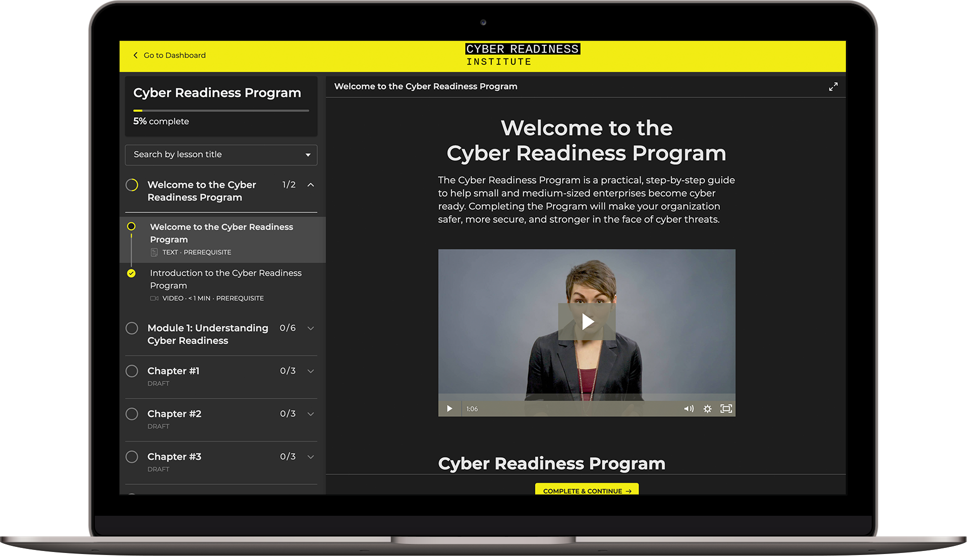
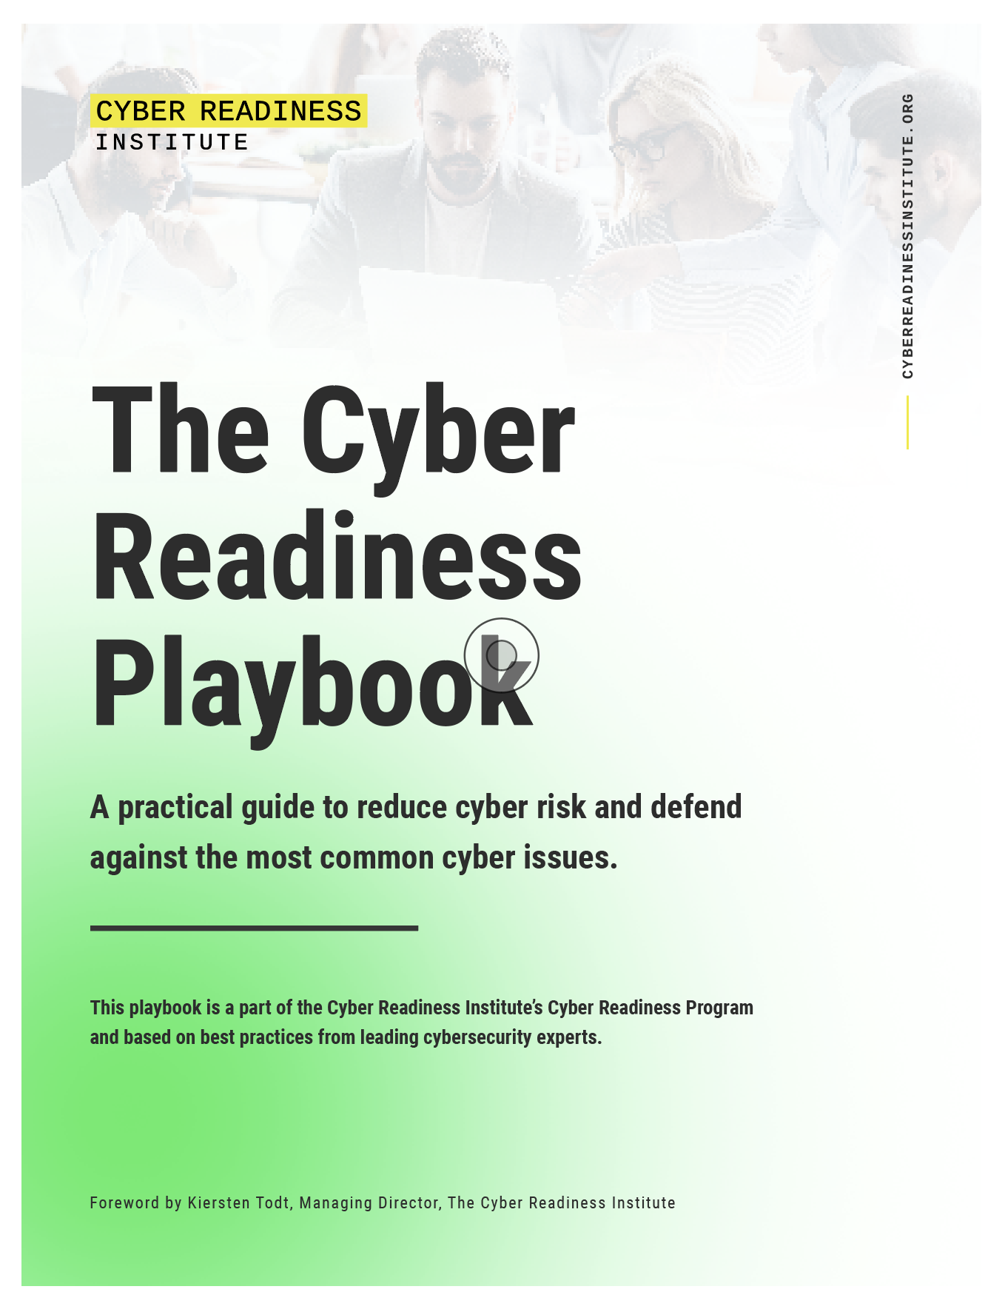
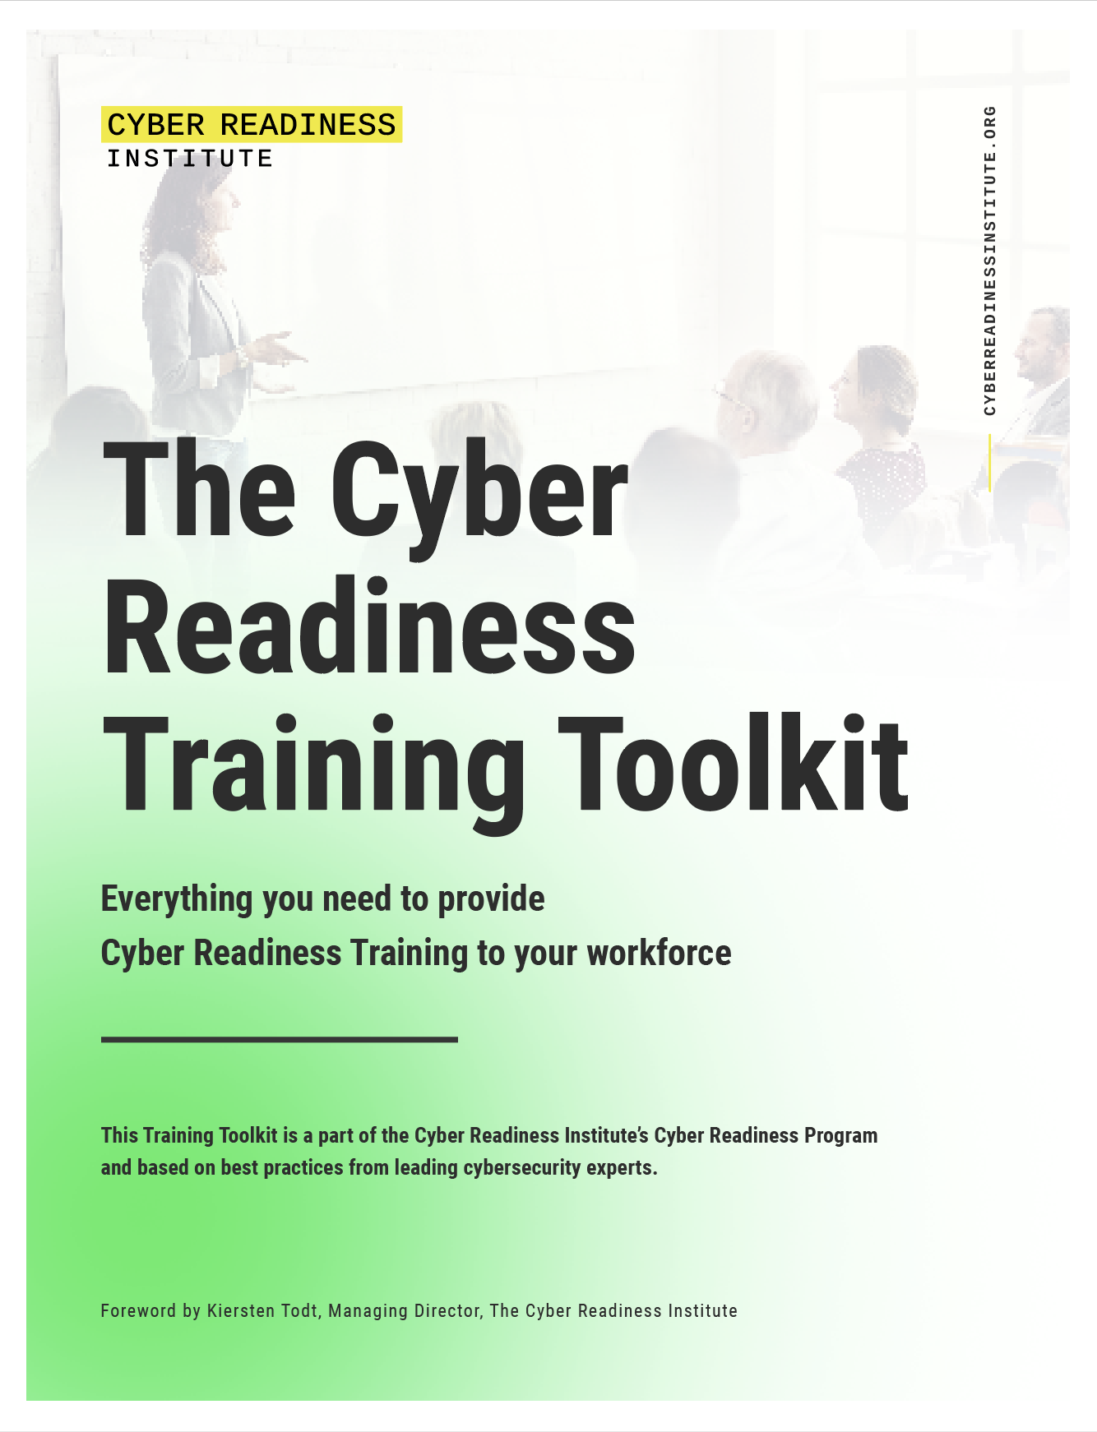
Included Free in the Program
Cyber Readiness Playbook
Actionable, easy-to-customize Playbook with clear directives and guidance for company security policies and a simple Incident Response Plan with instructions for how to handle a security breach.
Online Management Security Training
Employee Training Materials
A simple, easy-to-understand online course for the Cyber Leader that requires no technical understanding, can be completed at any pace, and on any device. The online training also offers instructor access and support with in-lesson discussion boards and a private Program community board for peer-to-peer support.
Complete kit of workforce training materials to use to train employees via remote video conference, in-person meeting, or via email. Train in short 10-minute sessions or together in a single session format.

Slide 10
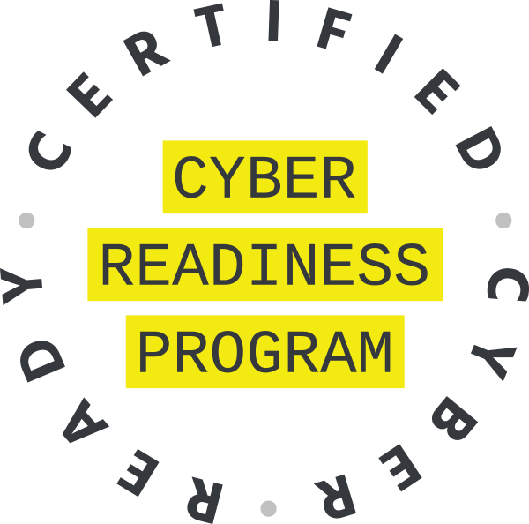
Cyber Readiness Certificate
Organizations who complete the Program and employee training can download a Certificate of Completion to record their commitment and share with their network.
Sign up at BeCyberReady.com

Slide 11

About the
Cyber Readiness Institute
The Cyber Readiness Institute (CRI) brings together the expertise of senior executive leaders at global companies – including Mastercard, Microsoft, ExxonMobil, Principal Financial Group, General Motors, PSP Partners, and the Center for Global Enterprise – to develop free resources to improve cyber readiness and secure global value chains.

